Slide 1
顆伴商店及shop.com最新發展
The Development of Partner Store & Shop.com
Chris Wong
高級業務拓展主任
Senior Business Development Executive

Slide 2
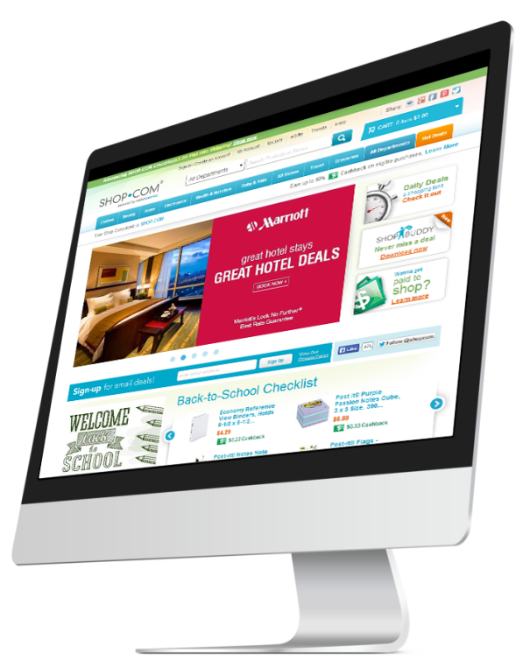
美安香港入門網站
HK.SHOP.COM

Slide 3
獨家代理品牌產品
2% 現金回贈
2% Cashback

Slide 4
賺取2%-25%現金回贈
Earn 2%-25% Cashback
你及你的顧客可進入超過1,300間夥伴商店消費
You and your customers gain access to over 1,300 stores

Slide 5
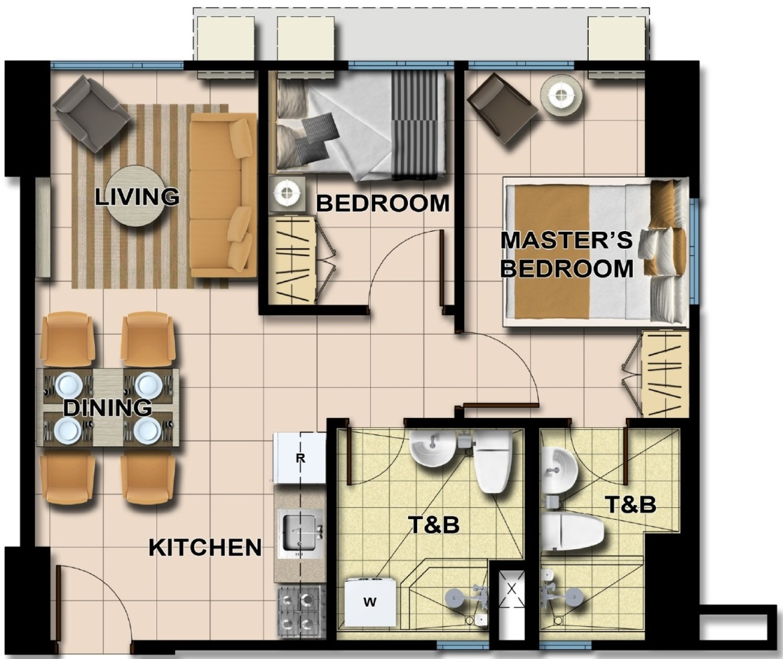
為每一項消費節省開支 Save money for every expense

Slide 6
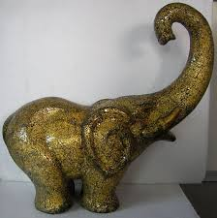
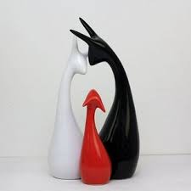
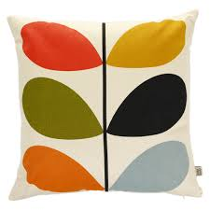
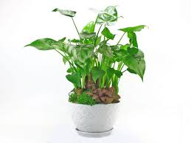
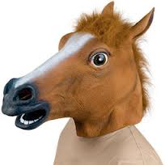
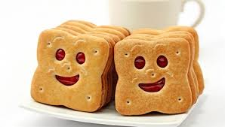
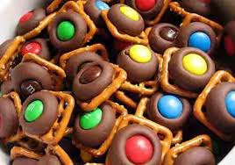
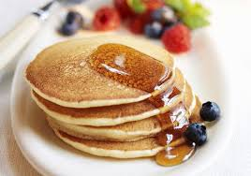
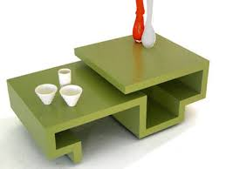
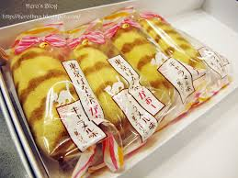
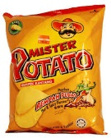
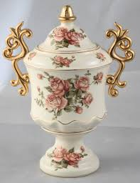
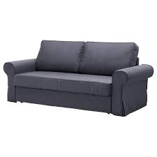
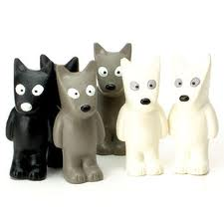

Slide 7
推薦新優惠顧客，額外賺取每次消費0.5%現金回贈
Refer new Preferred Customer, you can earn 0.5% Cashback of each qualified transaction

Slide 8
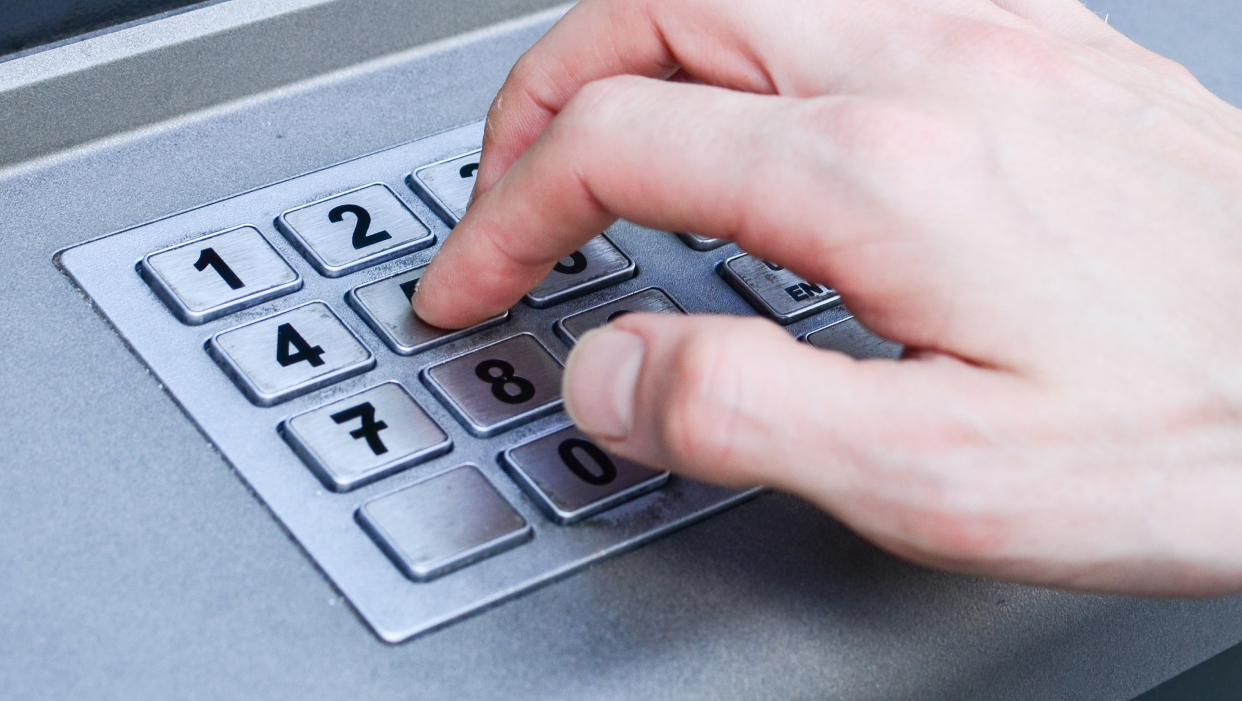

Slide 9
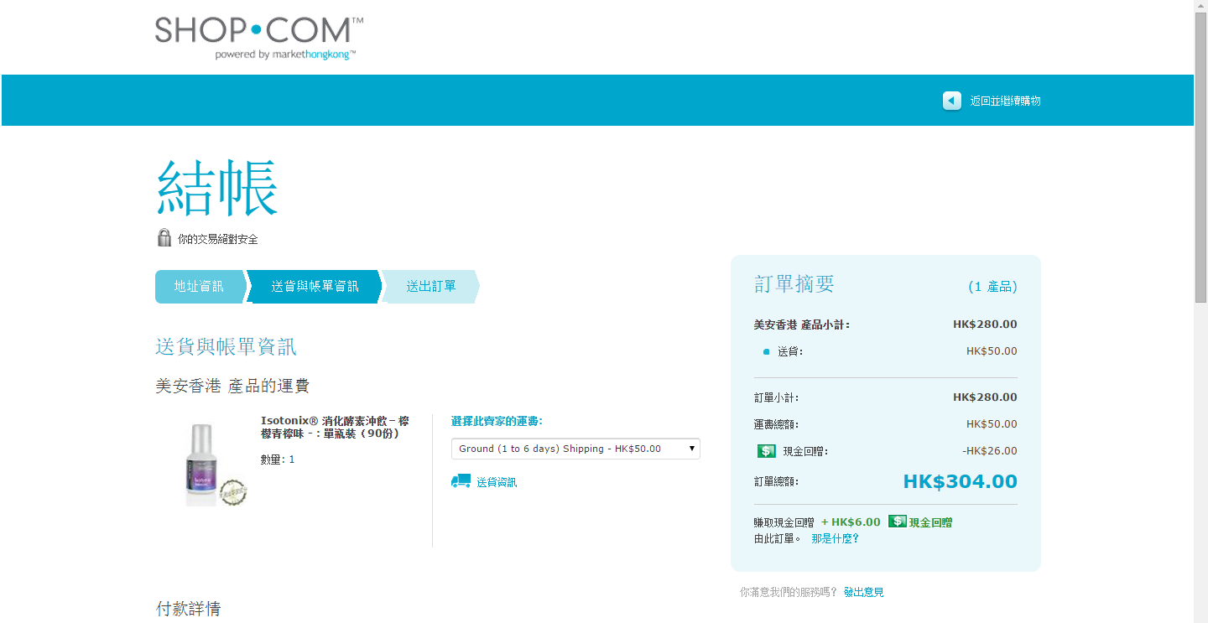
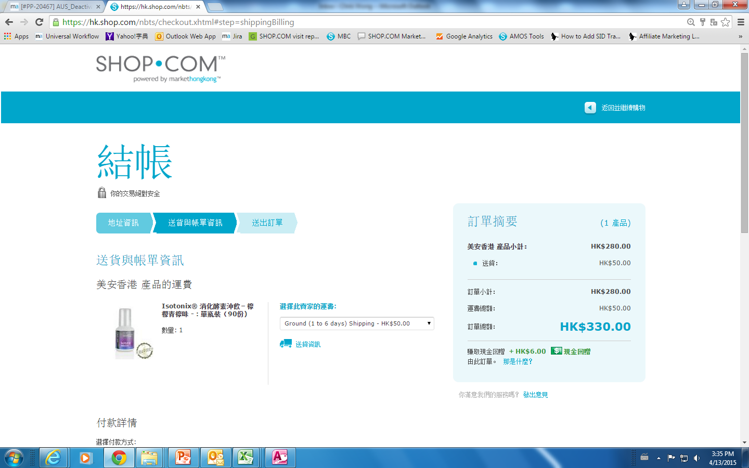
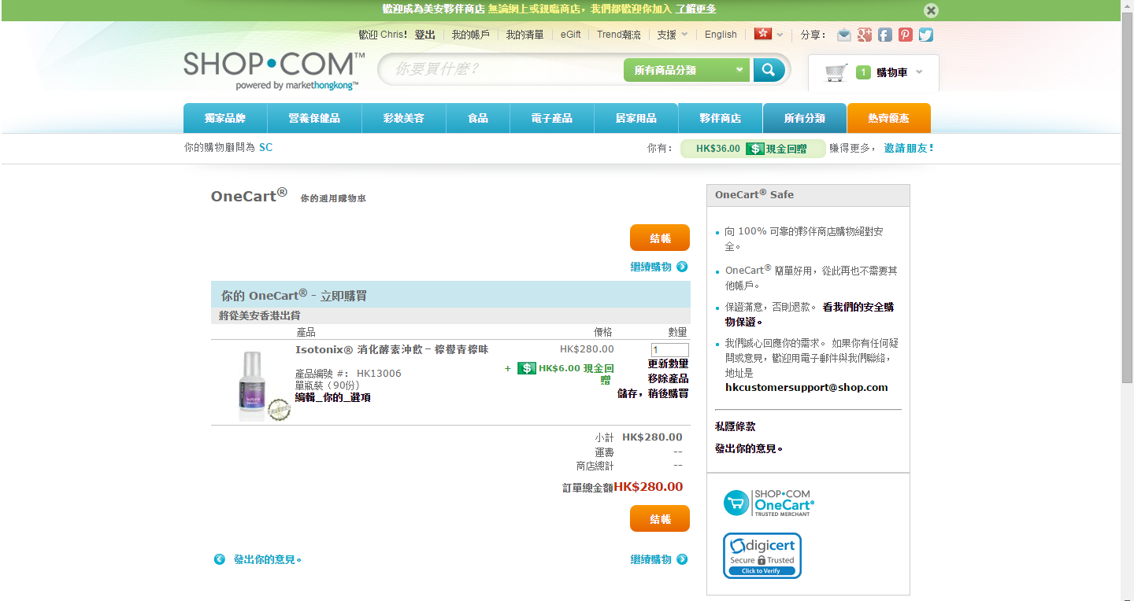
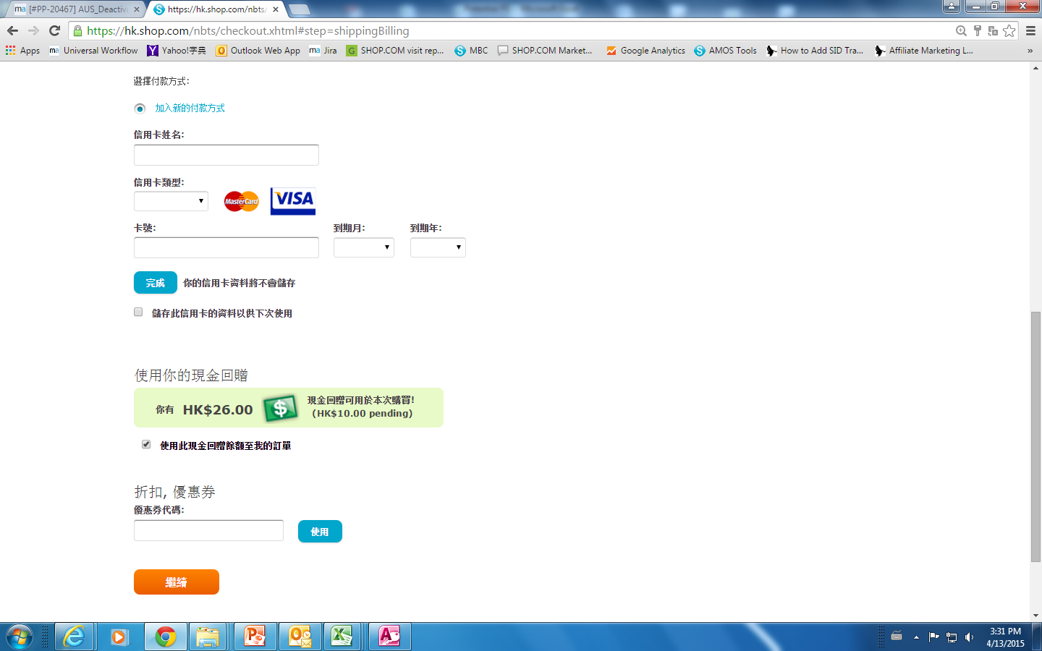
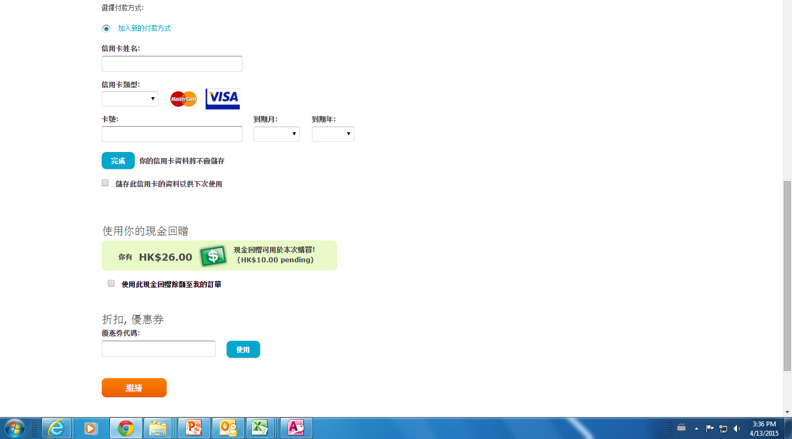

Slide 10
Ship to you home regularly
定期將產品送到家中
Only MHK Products
只限美安香港獨家產品
Save at least 5%
慳最少 5%
AutoShip 自動送貨

Slide 11
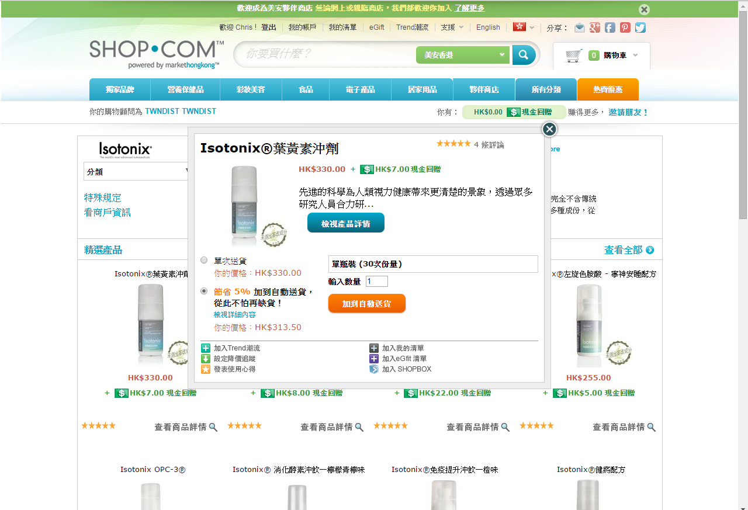
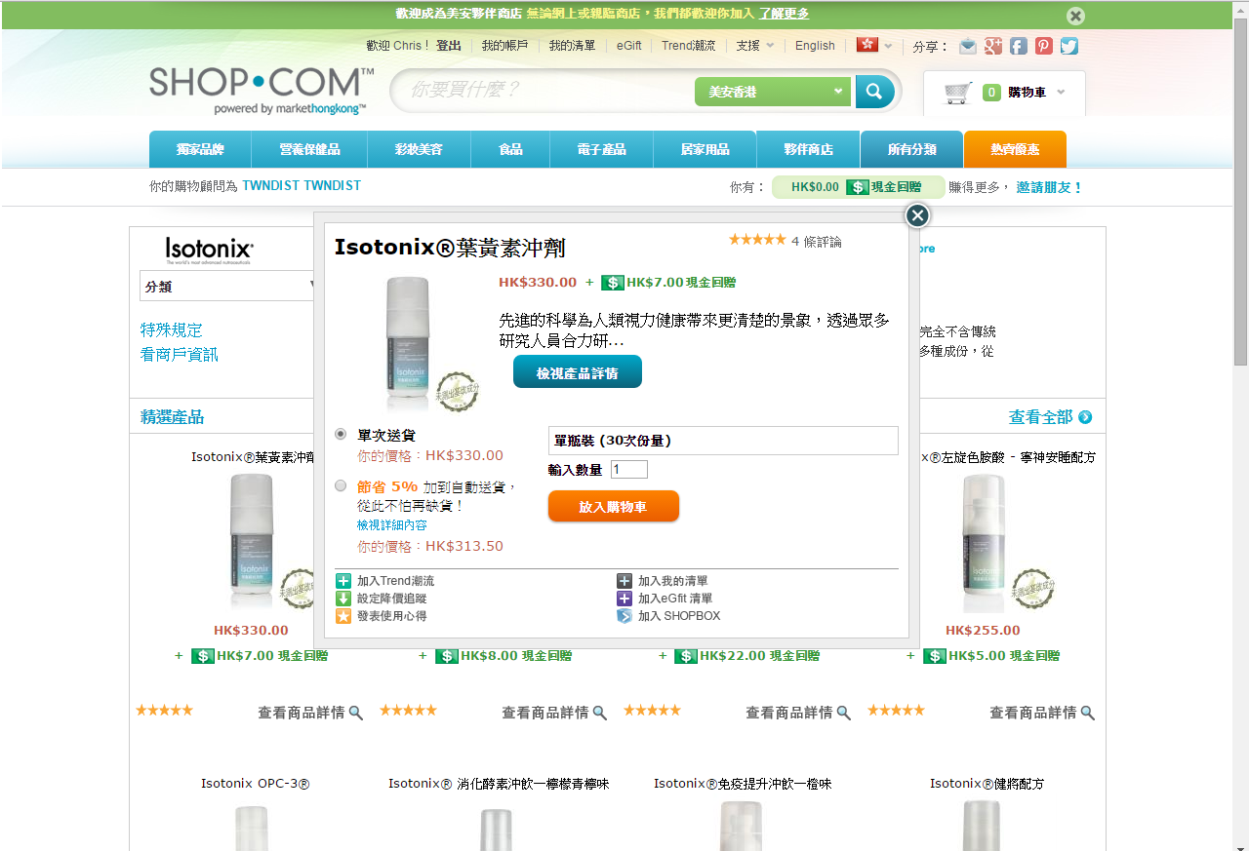
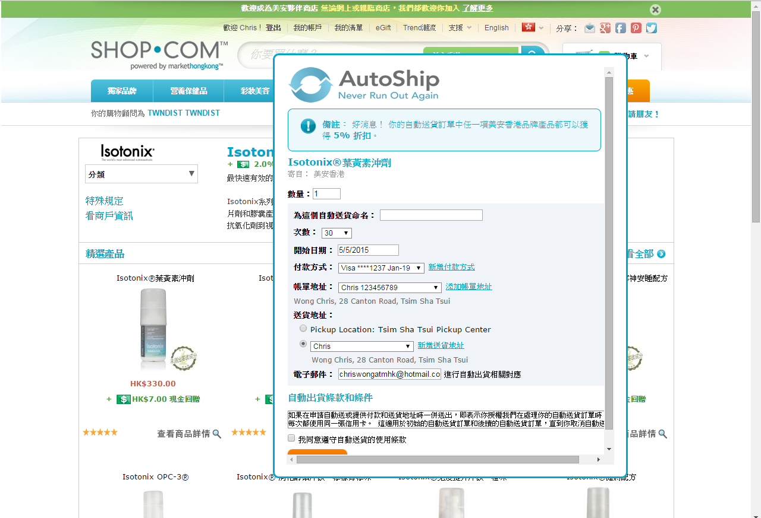

Slide 12
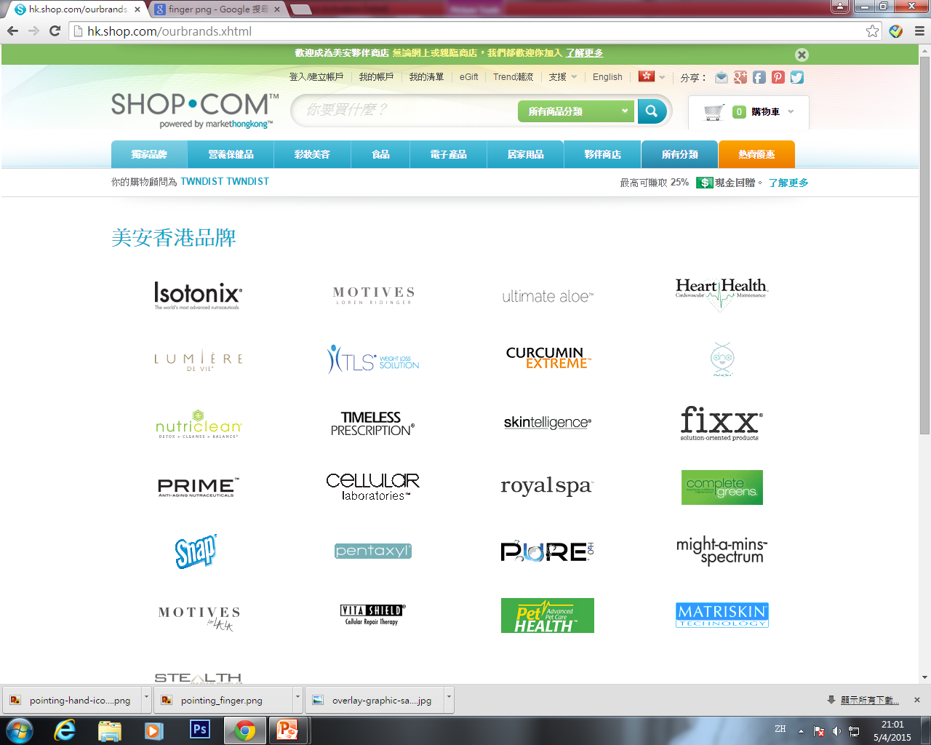
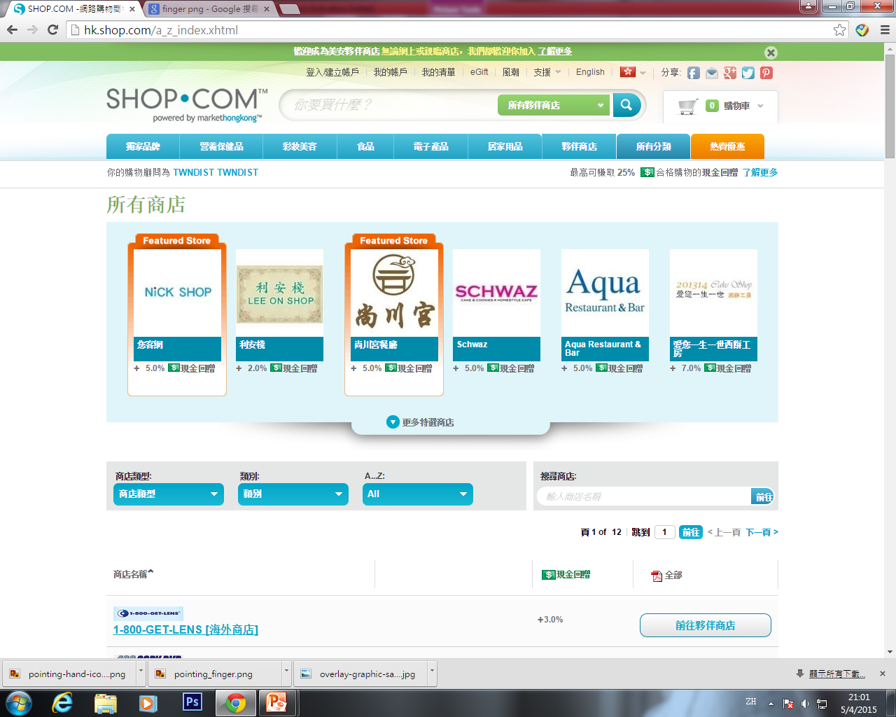
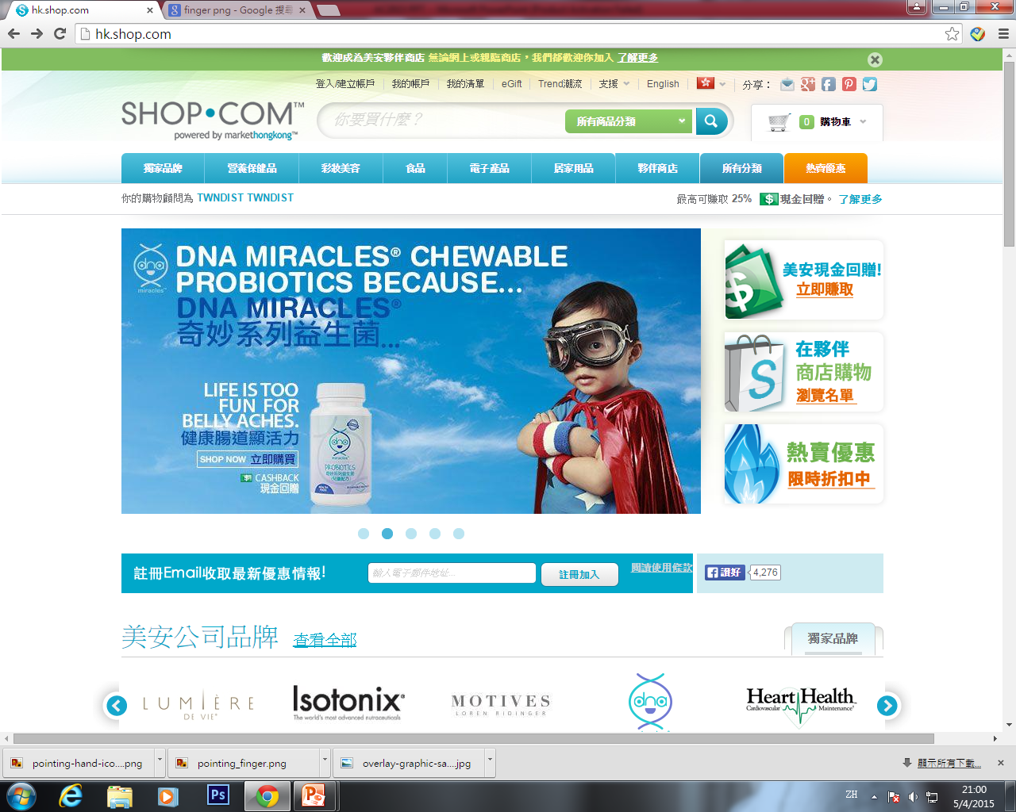
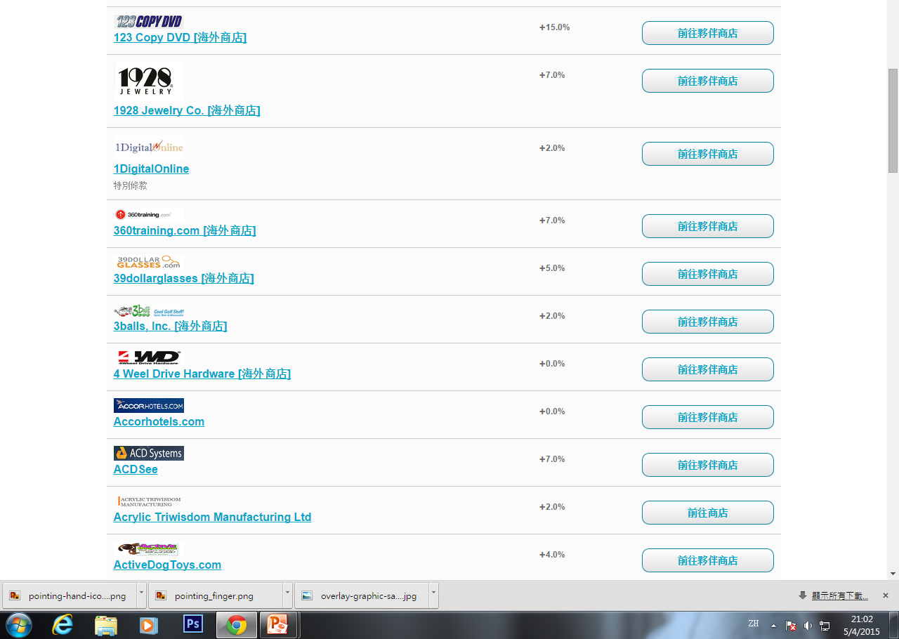
Search the products you want
搜尋你想要的產品

Slide 13
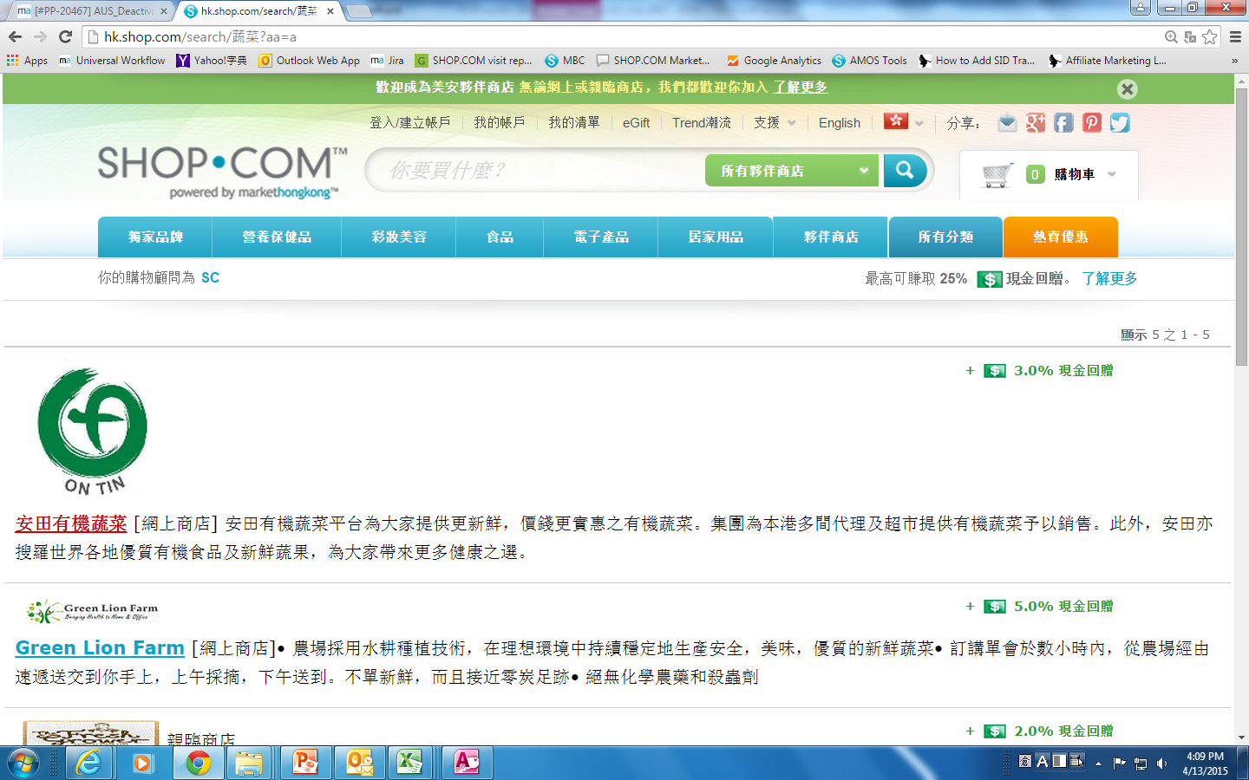
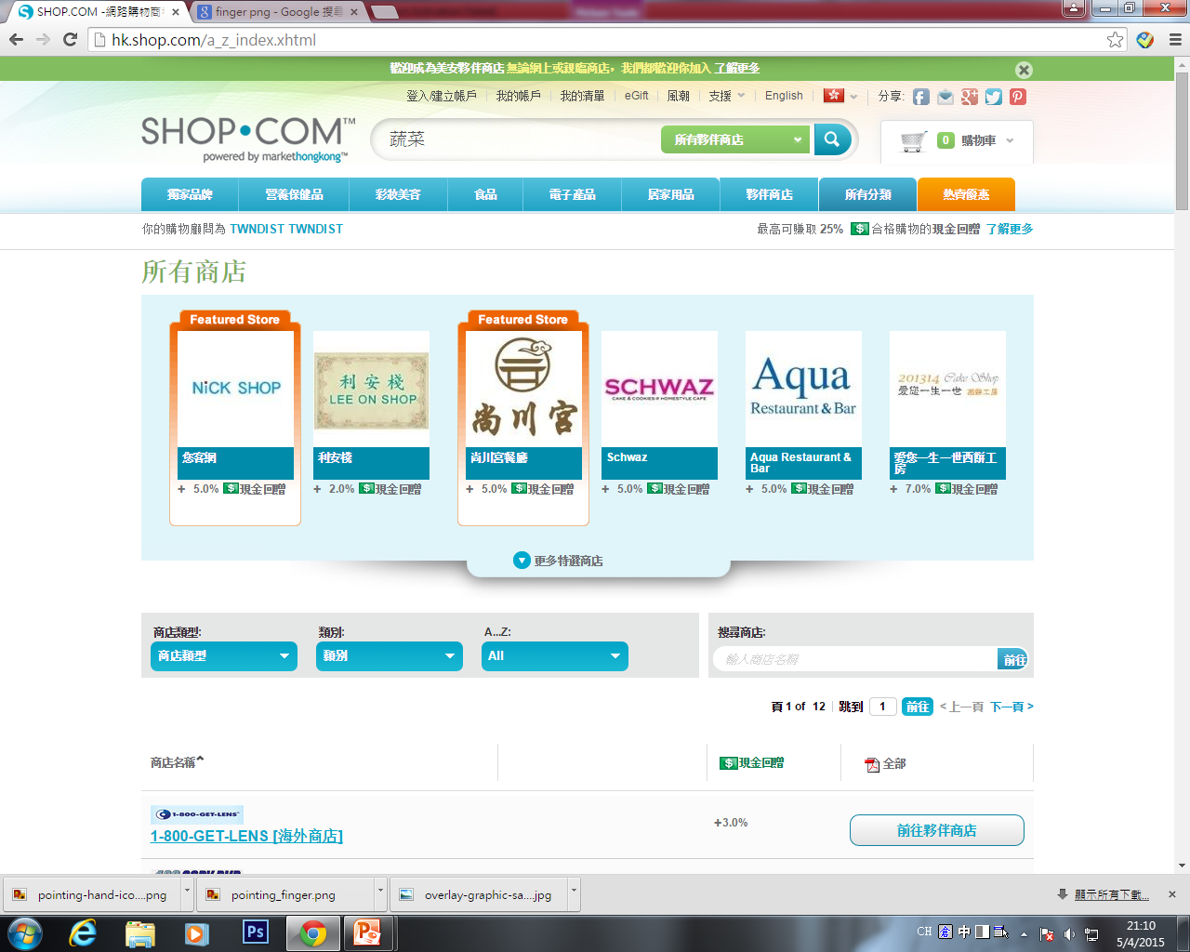
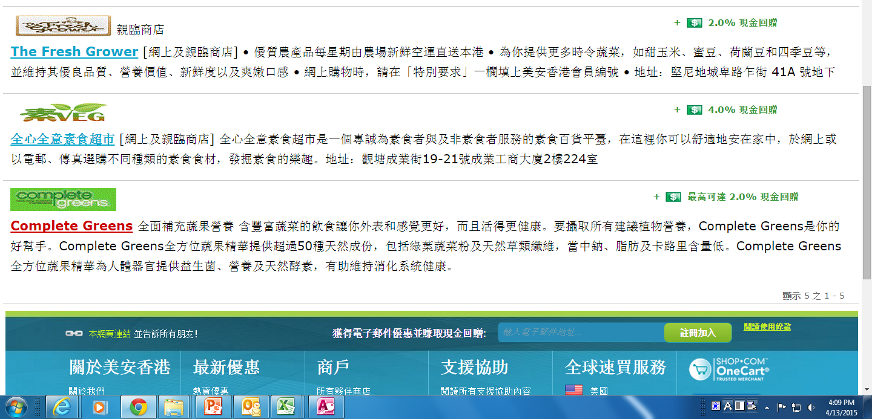

Slide 14
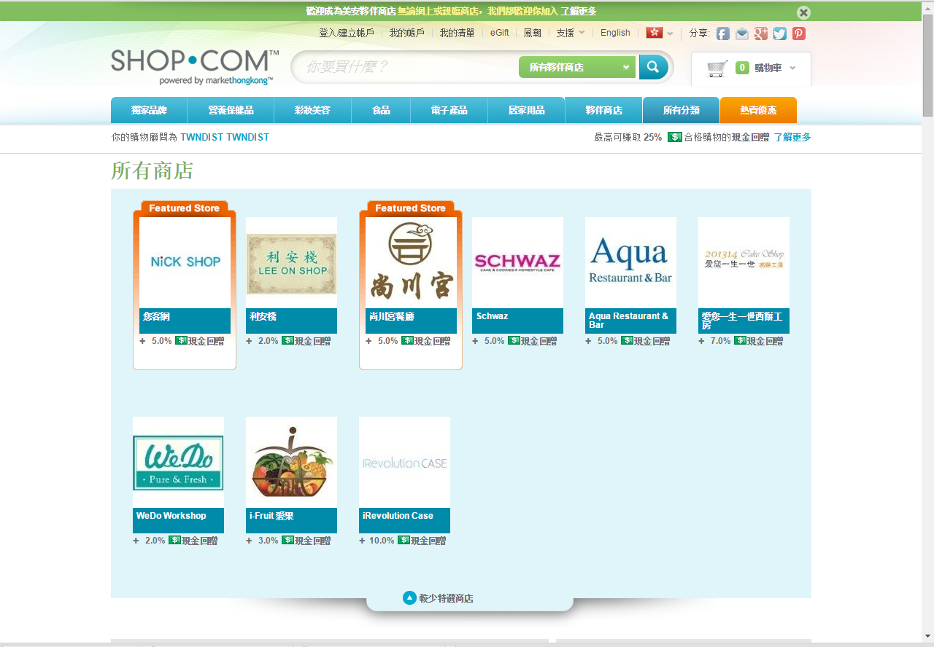
New stores 新夥伴商店

Slide 15
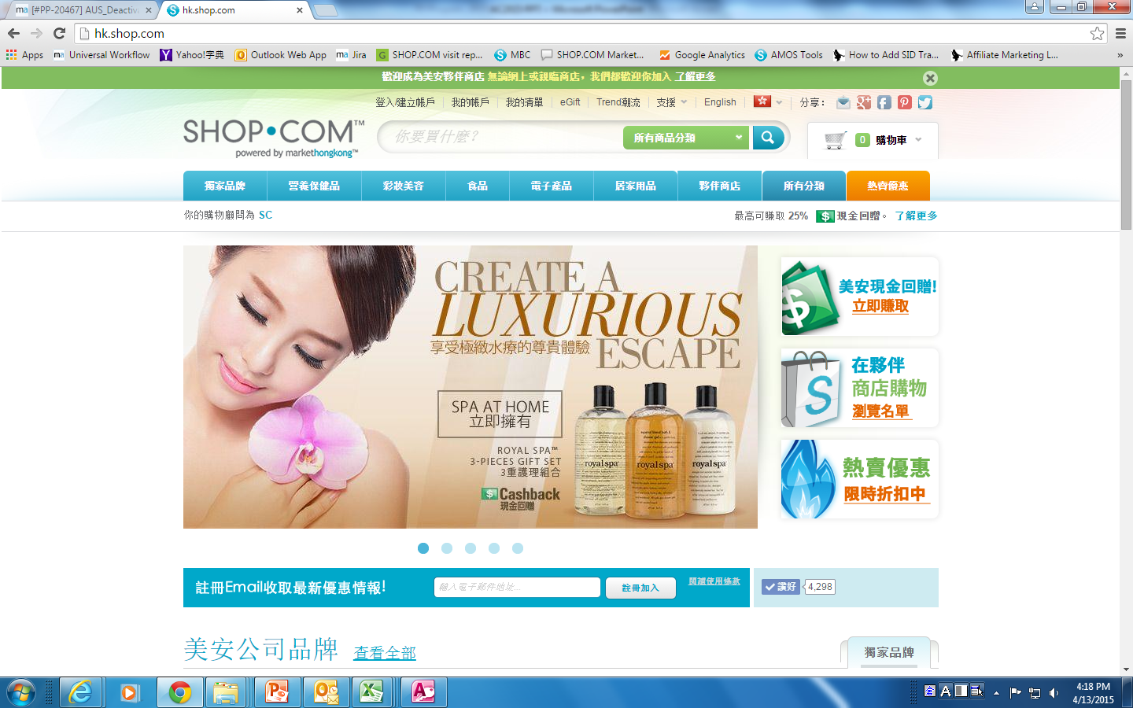
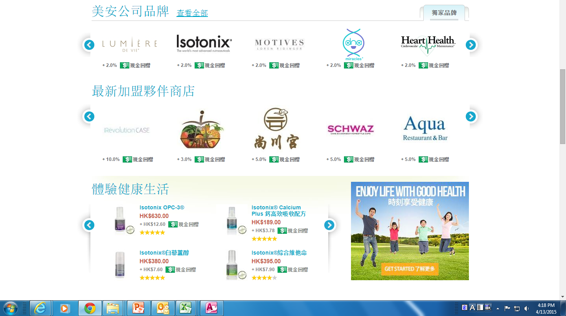

Slide 16
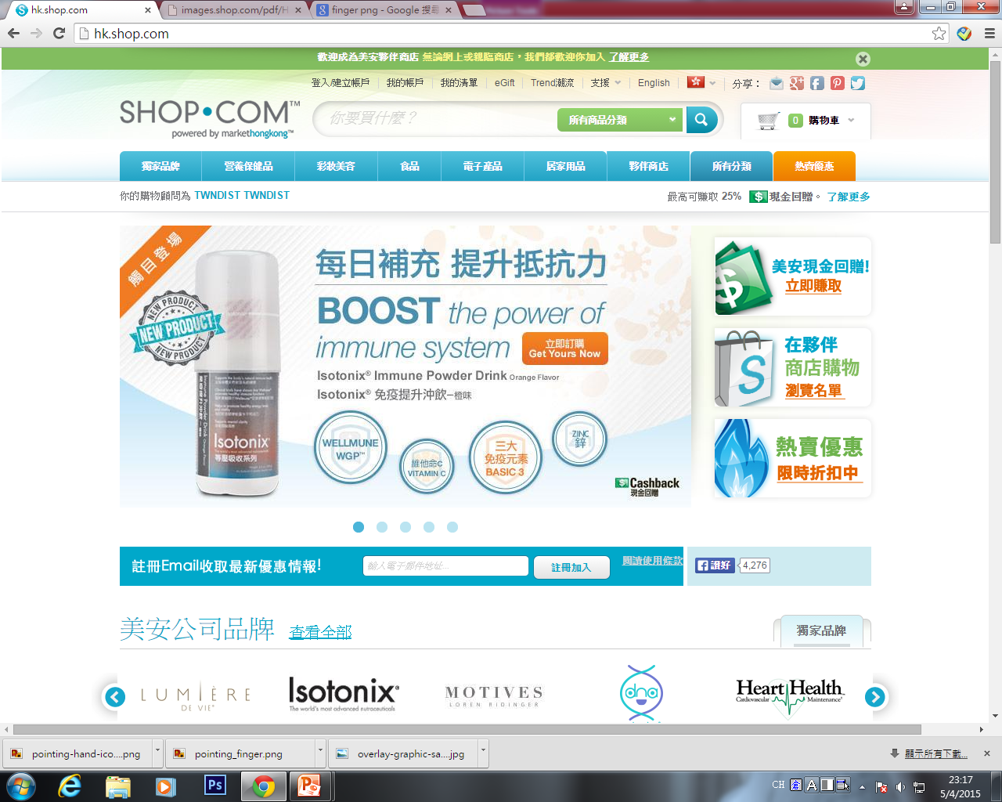
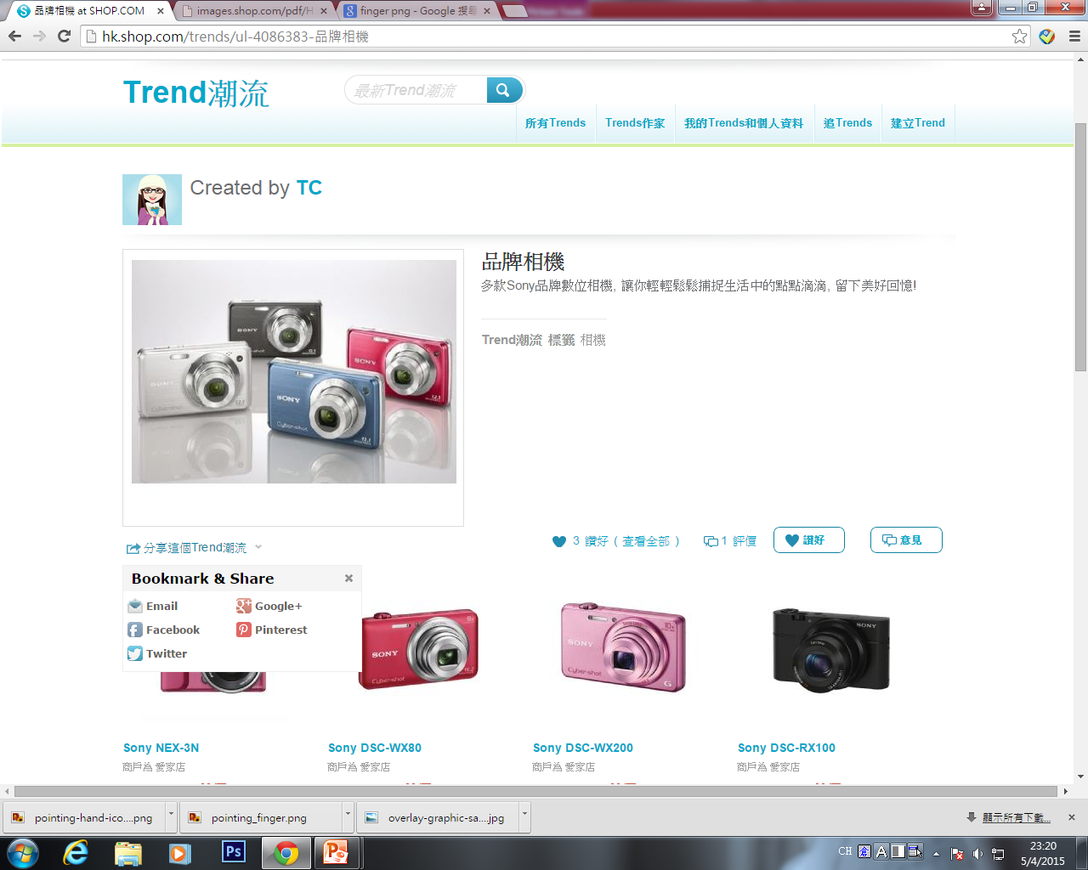
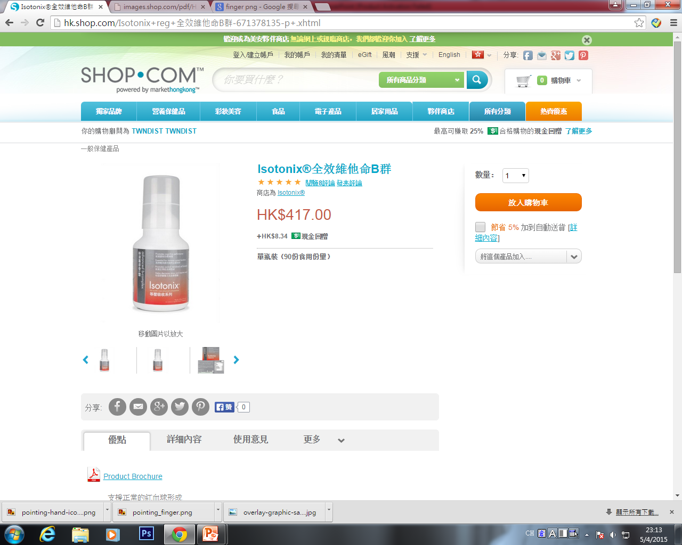
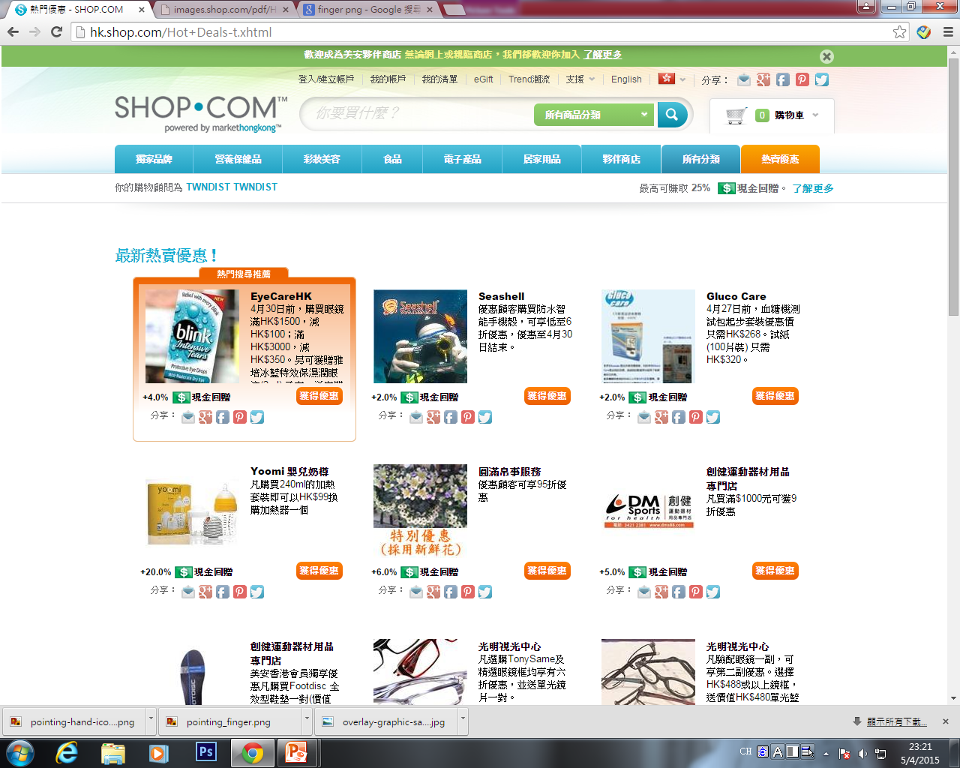
Share info 分享資訊

Slide 17
推薦新優惠顧客，額外賺取每次消費0.5%現金回贈
Refer new Preferred Customer, you can earn 0.5% Cashback of each qualified transaction

Slide 18
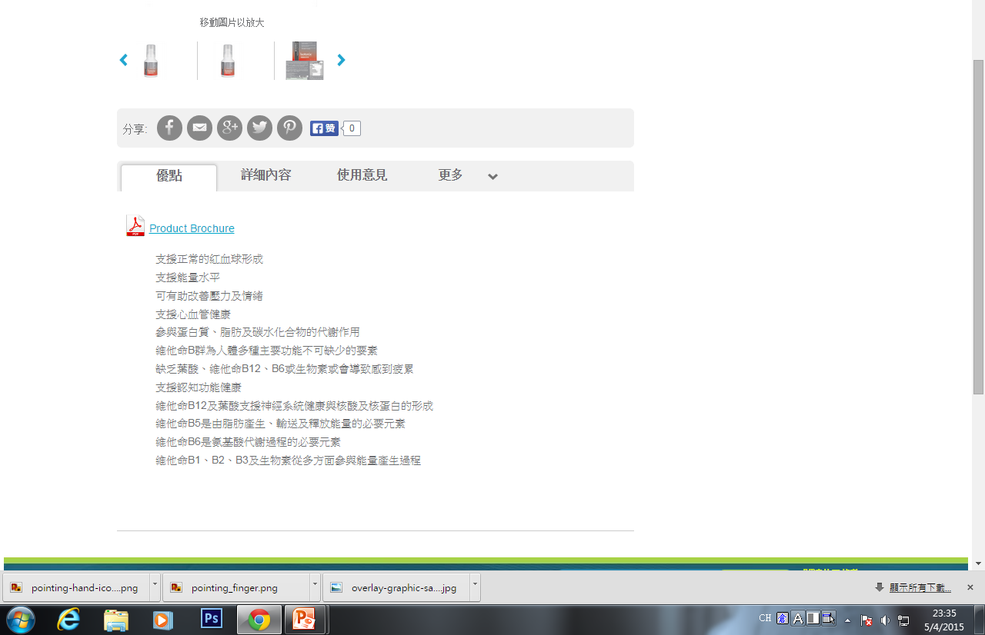

Slide 19
Shopping Annuity and Partner stores
購物年金及夥伴商店

Slide 20
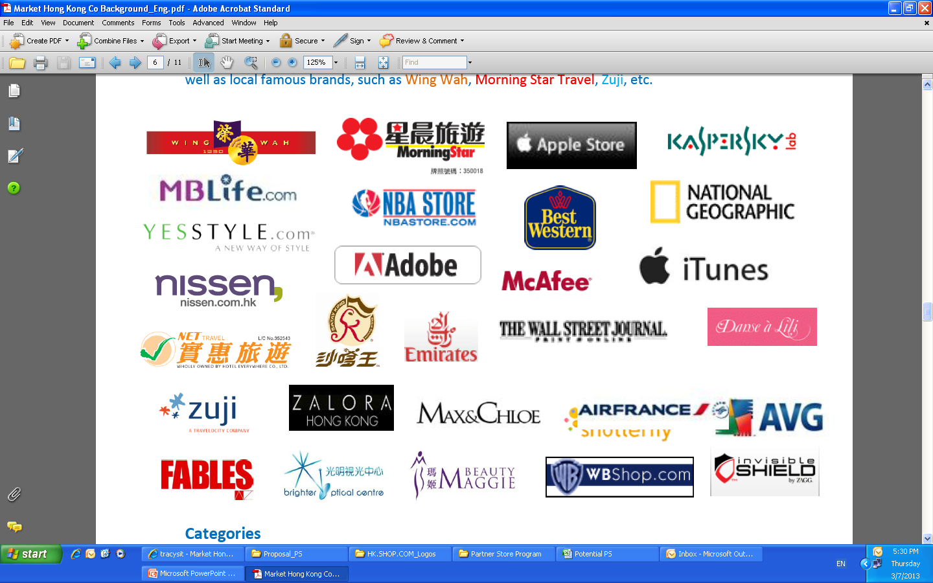
1300間夥伴商店提供 2%-25%現金回贈
1,300 Partner stores providing 2%-25% Cashback

Slide 21
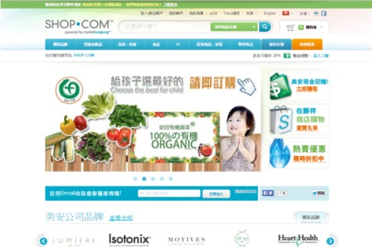
如何消費
How to purchase
在商店消費可得到現金回贈 + IBV
經HK.SHOP.COM前往商店購物
完成購物稍後可登入HK.SHOP.COM並查閱過往交易紀錄
Shop at partner stores you can earn Cashback + IBV
Visit and shop at stores through HK.SHOP.COM
Finish the purchase and then you can login to HK.SHOP.COM to review your shopping history later.

Slide 22
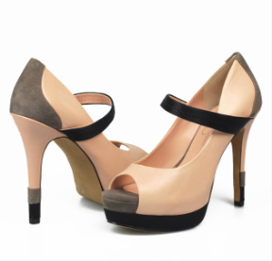
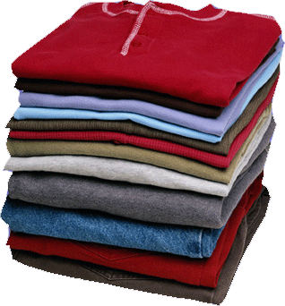
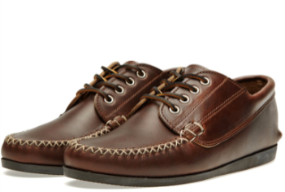
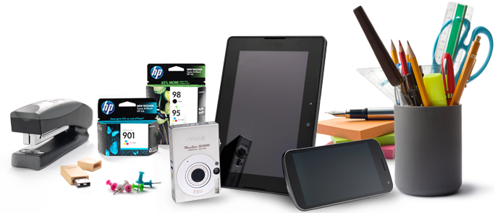
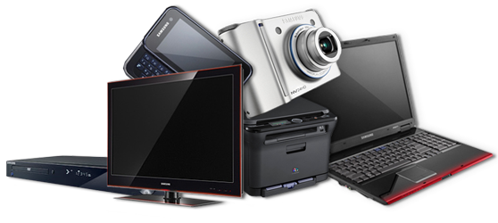
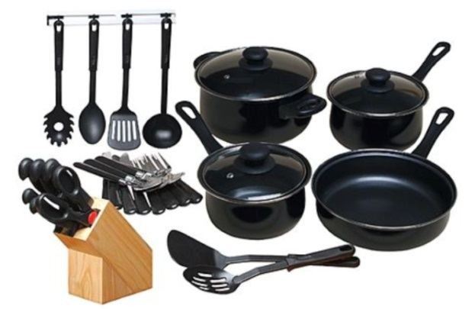
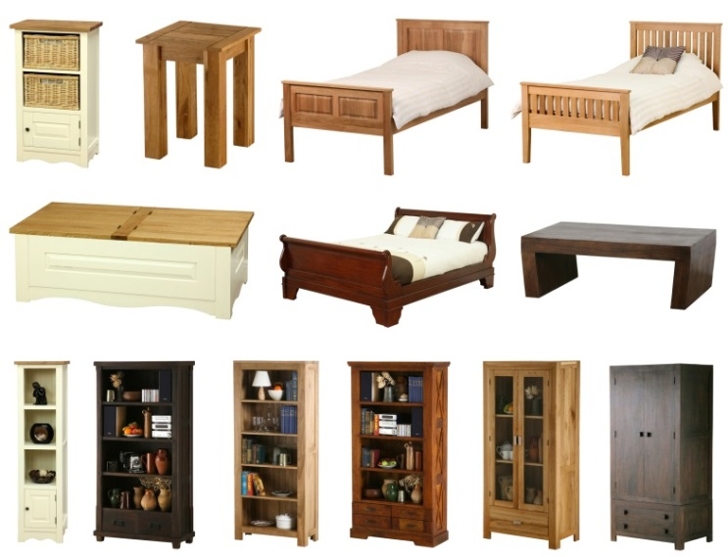
服飾 Clothes
食物 Food
+ IBV
電器
Electronics
家居用品
Home products
廚具
Cookware
傢俱
Furniture
清潔用品
Clean supplies

Slide 24
IBV
IBV
IBV
IBV
IBV
IBV
IBV
IBV
IBV

Slide 25
Life is filled up with products
人生每一個階段均由不同產品填滿

Slide 26
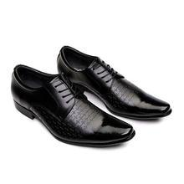
HK$1,790
$53.7 4.59 IBV
HK$780
$15.6 3 IBV
HK$730
$36.5 2.8 IBV
HK$188
$7.5 0.48 IBV
HK$1,288
$25.7 4.95 IBV
HK$383
$15.3 0.98 IBV

Slide 27
邊買、邊賺 Go Shopping & Getting paid 甚至搭車！ Even Transportation!
Market HK MEMBER

Slide 28
夥伴商店銷售總額
2013-14
98.7%
2014-15
458.8%
280.7%
107.3%
Shopping Annuity’s impact
購物年金額帶來的衝擊

Slide 29
To strengthen the SA synergy
加強購物年金

Slide 32
服飾 Clothes
食物 Food
電器
Electronics
家居用品
Home products
Which category is the most popular one?
哪一個類別最受歡迎?
廚具
Cookware
傢俱
Furniture
清潔用品
Clean supplies

Slide 33
Restaurant
餐廳
Food
食品
So, our plan?
那麼，我們的目標是…?
Clothes
服飾
Electronics
電子產品
Survey from local UFOs at Product Expos
從每次產品博覽中調查，對象是本地的超連鎖店主

Slide 34
5% IBV + 5%
杏花樓中式餐廳，火鍋、甜品專門店

Slide 35
4% IBV + 6%
美國梅西百貨公司銷售女性、男性及兒童的流行服飾，還有各樣配件、鞋類、手拿包、珠寶、手表、兒童用品、寢具。眾多美國知名品牌在macys.com都能買到。國際運送直接到府!

Slide 41
「2015區域大會」旅遊套票 - 新加坡
「2015國際會議」旅遊套票 - 美國
2% IBV

Slide 45
“Morning Star x SHOP.COM” Shopping bag
「星晨 x SHOP.COM」購物袋

Slide 46
Partner Store Fair
夥伴商店巡禮

Slide 47
參展夥伴商店

